Slide 1
Improving Interpretability of Deep Neural Networks with Semantic Information
Yinpeng Dong, Hang Su, Jun Zhu, Bo Zhang
23/04/2017
https://arxiv.org/abs/1703.04096
Notes:
探究的是深度学习的可解释性的研究

Slide 2
Contents
Background
Motivation
Methodology
Experiments
Human-in-the-loop Learning
Notes:
首先介绍可解释性的背景，然后提出我们工作的动机、方法和一些实验结果

Slide 3
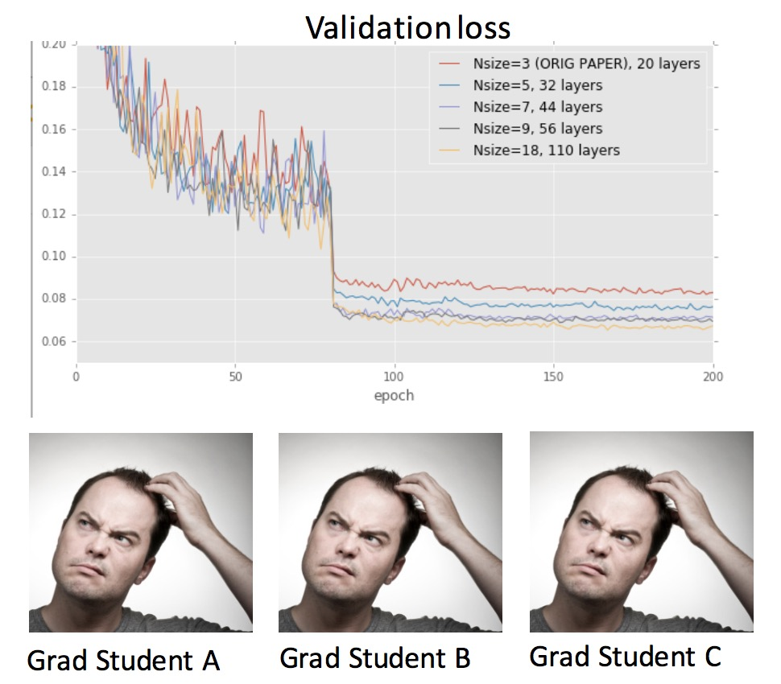
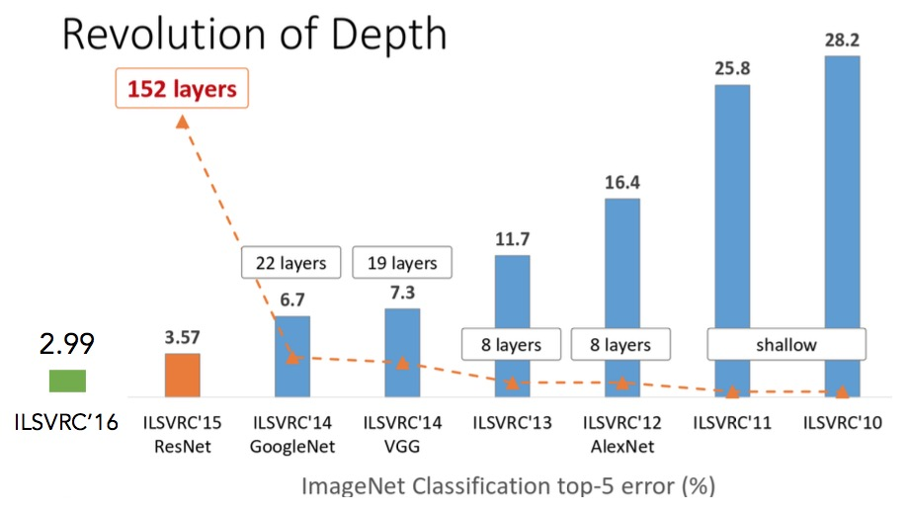
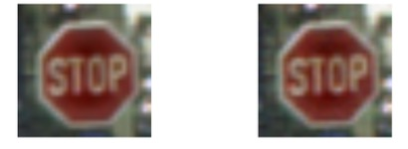
Why do we need Interpretability?
How to make models work?
When do you make a mistake?
Final output is a small
part of the story
Stop Sign
Yield Sign
Notes:
首先我们需要回答一个问题，我们为什么需要可解释性。这张图大家应该很熟悉，是ImageNet图像分类历年的错误率，可以看到2012年之后随着CNN技术的发展，提出了很多很有效的模型，top-5 error rate现在已经降到了5%。但是我们想要知道为什么这些模型有效，他们是如何提高结果的，如果只关注validation loss的话，我们只能得到很少的信息，不足以帮助我们发现模型的好处和缺点。
第二点，是我们希望了解模型为什么会出错。CNN模型被大家诟病的一个原因是鲁棒性很差，比如。。。如果不能了解模型出错的原因，那么这些基于深度学习的模型就不能应用到实际的场景中。

Slide 4
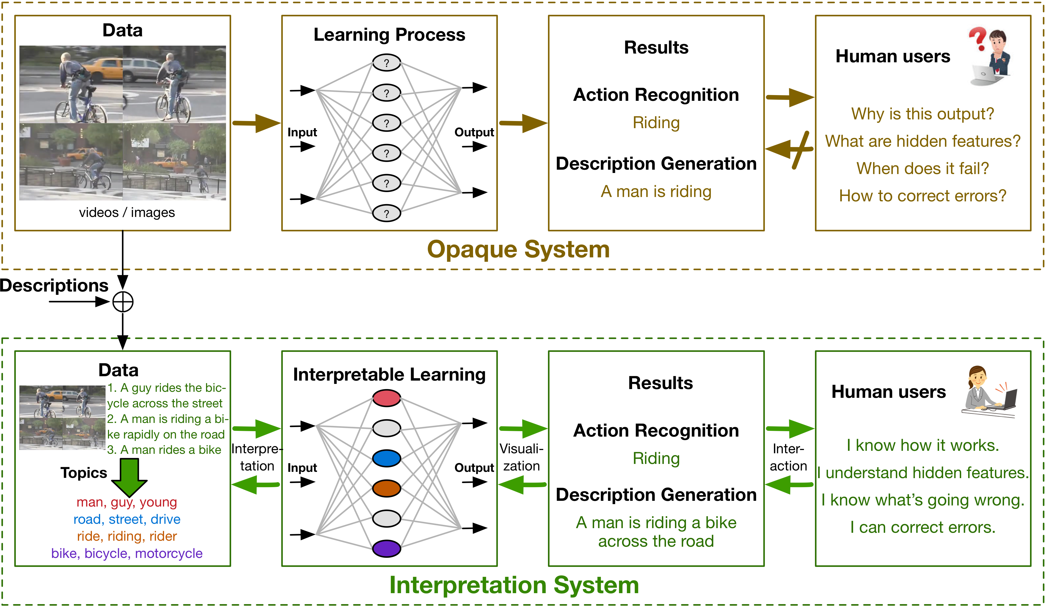
Interpretable Machine Learning
Notes:
而在可解释学习的模型下，用户能够知道模型为什么工作，理解其内部运行机理，所以在模型发生错误的时候能够知道哪里出了问题，针对性地去改进。要做到这些，就需要同模型的结果进行交互，并通过可视化的方法了解模型学习的特征。为了达到可解释模型的目的，可能我们还需要修改一些数据和学习算法。

Slide 5
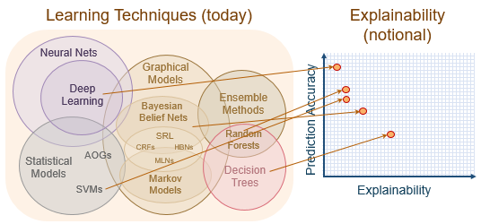
Purpose
Develop algorithms that facilitate users to understand the rationale for the system's decisions
Provide an explanation of individual decisions
Understand the system's overall strengths and weaknesses
Predict how the system will behave in the future
Correct the system's mistakes
Notes:
所以可解释性学习的目标主要包括为其决策作出解释，让用户了解系统的优势和弱势，预支系统在未来会如果表现，会不会发生严重的失误，并能够修复模型的错误。更高层一点，我们还希望从模型中发掘知，比如在RL中可以发掘一些模型学习到的策略，帮助人们提升自己的认识水平。

Slide 6
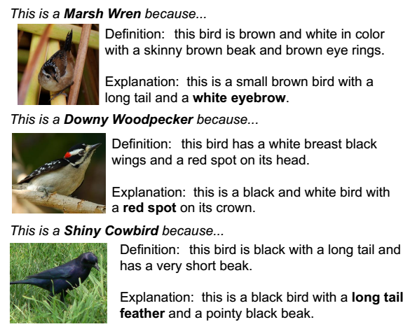
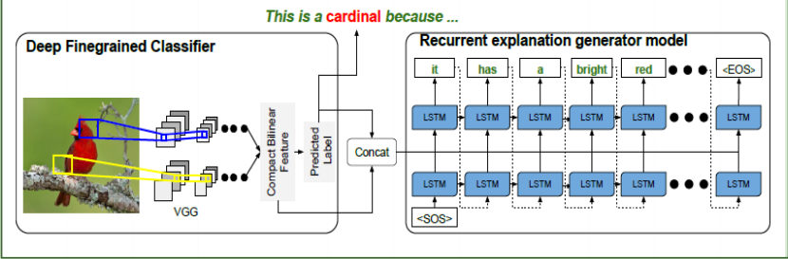
Related Works
Justification: Jointly predict a class label, and explain why the predicted label is appropriate for the image
Hendricks L.A., Akata Z., Rohrbach M., Donahue J., Schiele B., Darrell T. (2016) Generating Visual Explanations. In:Computer Vision – ECCV 2016.

Slide 7
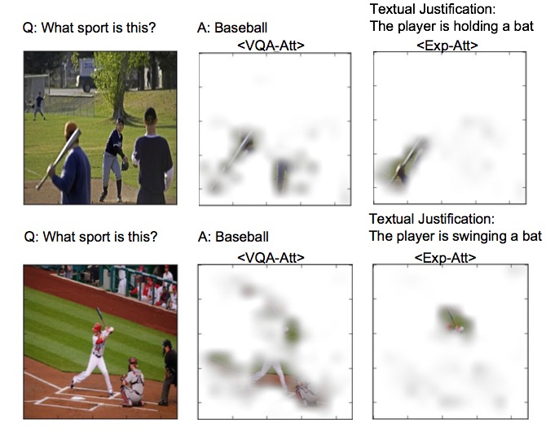
Related Works
Justification and pointing to the evidence
Park, D. H., Hendricks, L. A., Akata, Z., Schiele, B., Darrell, T., & Rohrbach, M. (2016). Attentive Explanations: Justifying Decisions and Pointing to the Evidence. arXiv preprint arXiv:1612.04757

Slide 8
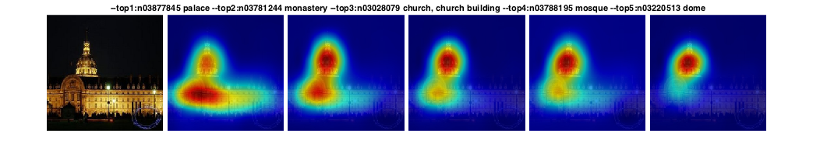
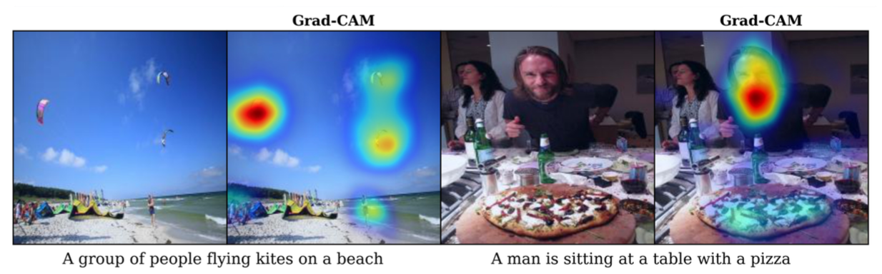
Related Works
Visualization
Zhou, B., Khosla, A., Lapedriza, A., Oliva, A., & Torralba, A. Learning deep features for discriminative localization. In CVPR 2016.
Selvaraju, R. R., Das, A., Vedantam, R., Cogswell, M., Parikh, D., & Batra, D. Grad-CAM: Why did you say that?. arXiv preprint arXiv:1611.07450.

Slide 9
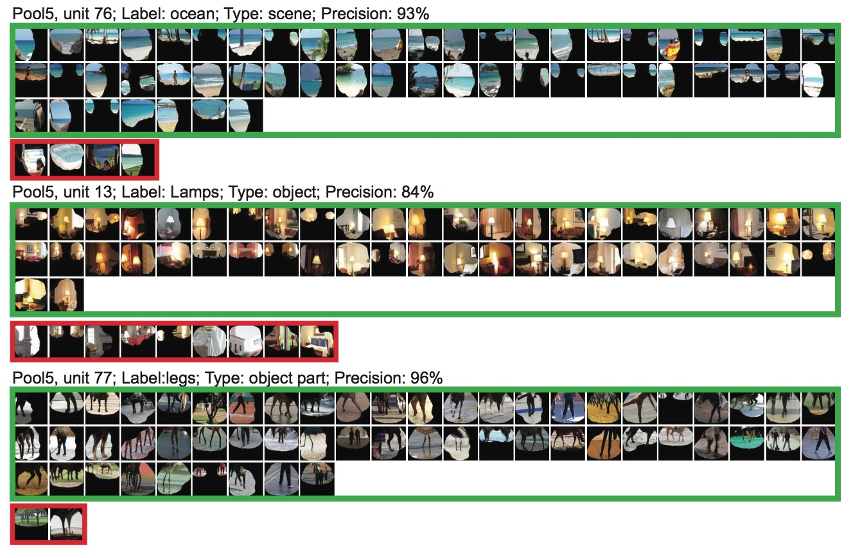
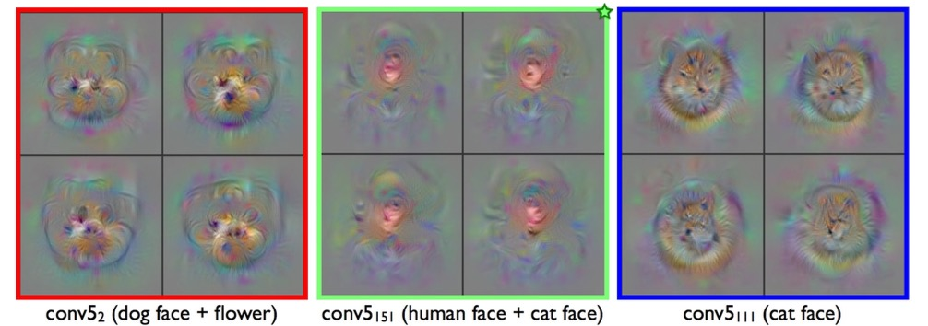
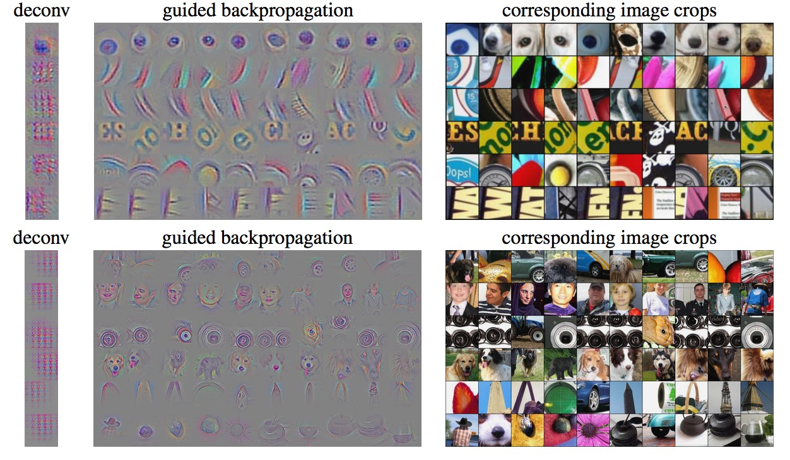
Related Works
Visualization
Yosinski, J., Clune, J., Nguyen, A., Fuchs, T., & Lipson, H. Understanding neural networks through deep visualization. In ICML 2016.
Striving For Simplicity: The All Convolutional Net
Zhou, B., Khosla, A., Lapedriza, A., Oliva, A., & Torralba, A. Object detectors emerge in deep scene cnns. In ICLR 2015.

Slide 10
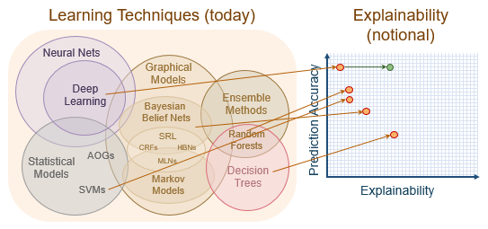
Challenges
Highly nonlinear functions and unclear working mechanism.
No clear definition.
There lack interpretation techniques for more complex architectures (involving CNN and RNN). The learned features are difficult to visualize and understand.
Previous works perform interpretation and visualization after the training process.
No interpretation for errors.
Notes:
研究可解释性学习面临着很多的挑战，之前的工作也是一些很基础的工作。首先，深度学习由于其非线性特性，很难从理论上研究清楚其工作原理。对于可解释性有没有一个明确的定义。而且，大部分工作都只是在结构很简单的卷积神经网络上做，对于复杂网络做可解释性分析更加困难。还要很重要的一点是，之前的的很多工作都在训练结束后进行，这是很受模型性能影响的，如果模型在具体任务上性能很差，其特征往往也是不可解释的。另外，对于模型出错的原因也没有分析。

Slide 11
Motivation
Incorporate the interpretability of hidden features during the learning process with semantic information. Force the model to induce interpretable features.
Video captioning
Complex architecture with uninterpretable features.
Rich semantic information embedded in descriptions.

Slide 12
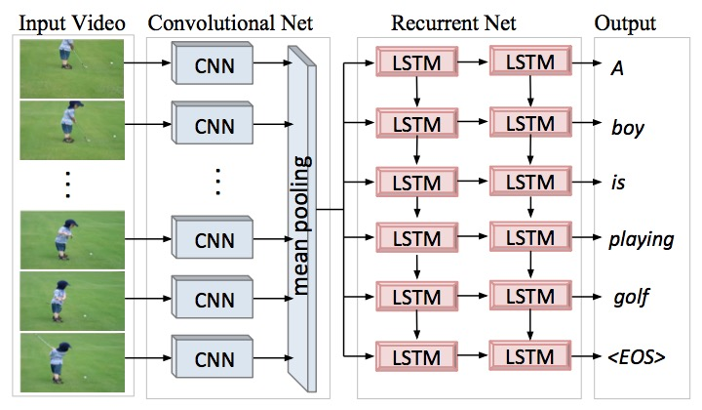
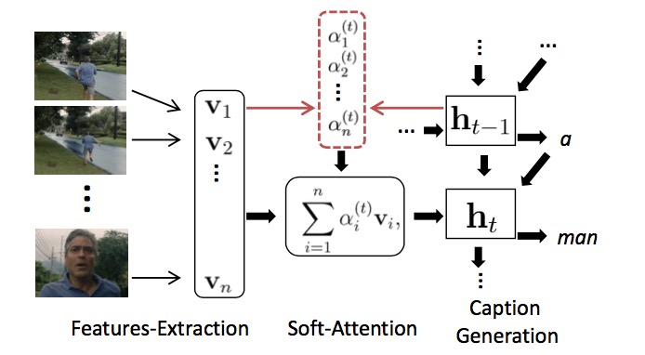
Video Captioning
Task: Automatically describe video content with a complete and natural sentence.
Notes:
Video caption任务是希望模型自动地为视频生成自然语言的描述，解决这个问题常用的结构是encoder-decoder结构，利用CNN对图像提取特征，在通过LSTM见特征转变为自然语言的描述。

Slide 13
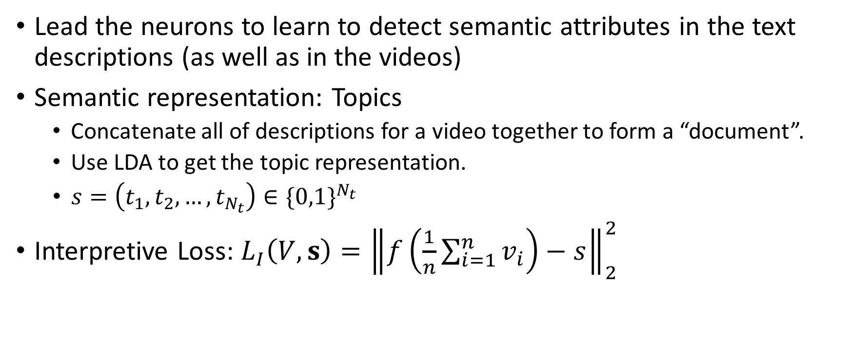
Interpretive Loss
Lead the neurons to learn to detect semantic attributes in the text descriptions (as well as in the videos)
Semantic representation: Topics
Concatenate all of descriptions for a video together to form a “document”.
Use LDA to get the topic representation.
$s=\left(t_{1},t_{2},…,t_{N_{t}}\right)∈{\{0,1\}}^{N_{t}}$
Interpretive Loss: $L_{I}\left(V, s\right)={\left\|f\left(\frac{1}{n}\sum_{i=1}^{n}{v_{i}}\right)−s\right\|}_{2}^{2}$
Notes:
由于传统的encoder-decoder结构对特征表示没有约束，所以可解释性很差。我们在其基础上，加入了interpretive loss，引导神经元自动地和视频中语义信息产生关联。这个loss也可以看做对特征的约束，使其在维持整体性能的同时，更好地与人们理解的语义一致。这里我们用topic代表语义信息。interpretive loss形式是将visual feature pooling到一起，然后通过f变换与topic表示的误差。可以看做是从视频特征预测topic的loss。

Slide 14
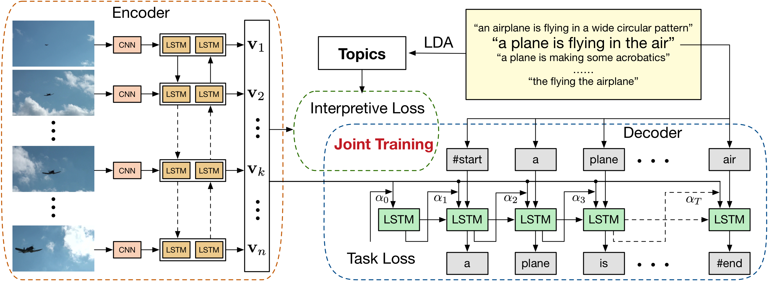
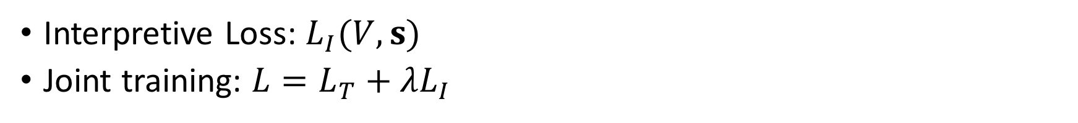
Framework
Interpretive Loss: $L_{I}(V, s)$
Joint training: $L=L_{T}+λL_{I}$

Slide 15
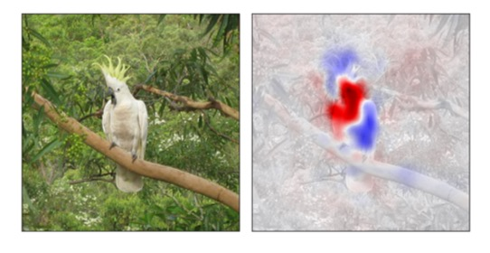
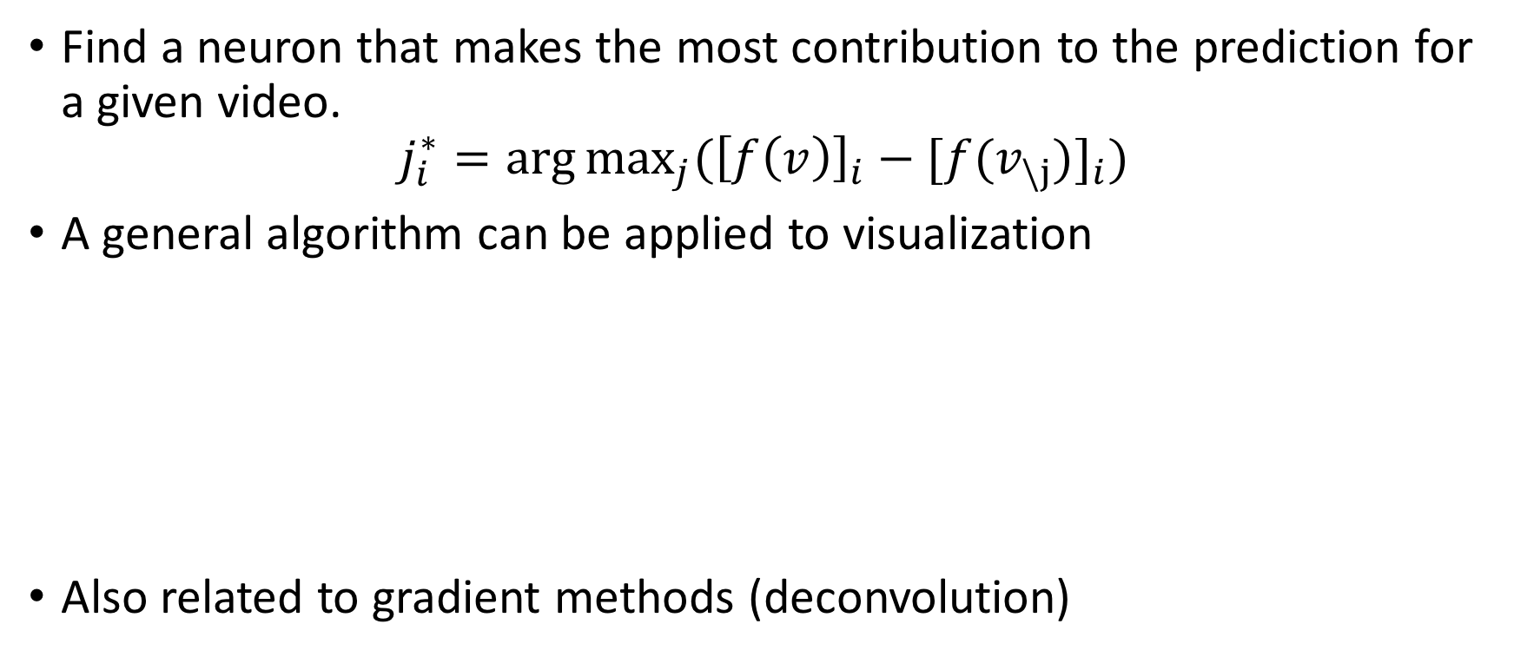
Prediction Difference Maximization
Find a neuron that makes the most contribution to the prediction for a given video.
$$j_{i}^{∗}=\arg{\max_{j}({\left[f\left(v\right)\right]}_{i}−{[f(v_{\backslash j})]}_{i})}$$
A general algorithm can be applied to visualization
Also related to gradient methods (deconvolution)
Zintgraf, L. M., Cohen, T. S., Adel, T., & Welling, M. (2017). Visualizing Deep Neural Network Decisions: Prediction Difference Analysis. In ICLR 2017.

Slide 16
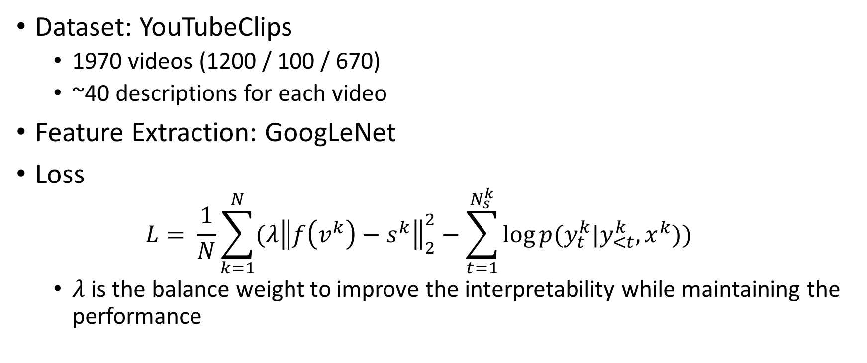
Experiments
Dataset: YouTubeClips
1970 videos (1200 / 100 / 670)
~40 descriptions for each video
Feature Extraction: GoogLeNet
Loss
$$L= \frac{1}{N}\sum_{k=1}^{N}{(λ{\left\|f\left(v^{k}\right)−s^{k}\right\|}_{2}^{2}−\sum_{t=1}^{N_{s}^{k}}{\log{p(y_{t}^{k}|y_{<t}^{k},x^{k})}})}$$
$λ$ is the balance weight to improve the interpretability while maintaining the performance

Slide 17
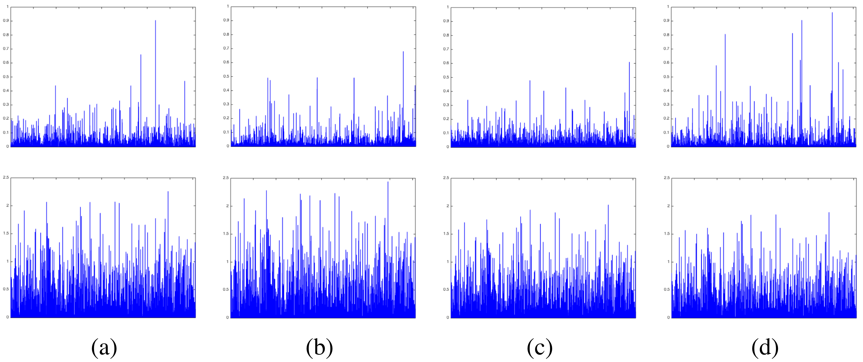
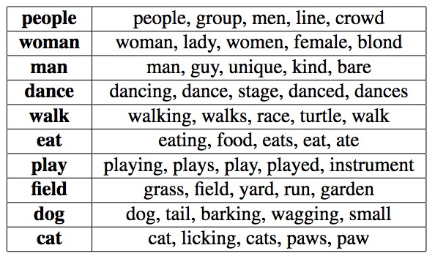
Feature Visualization
Dog
Girl
Walk
Dance

Slide 18
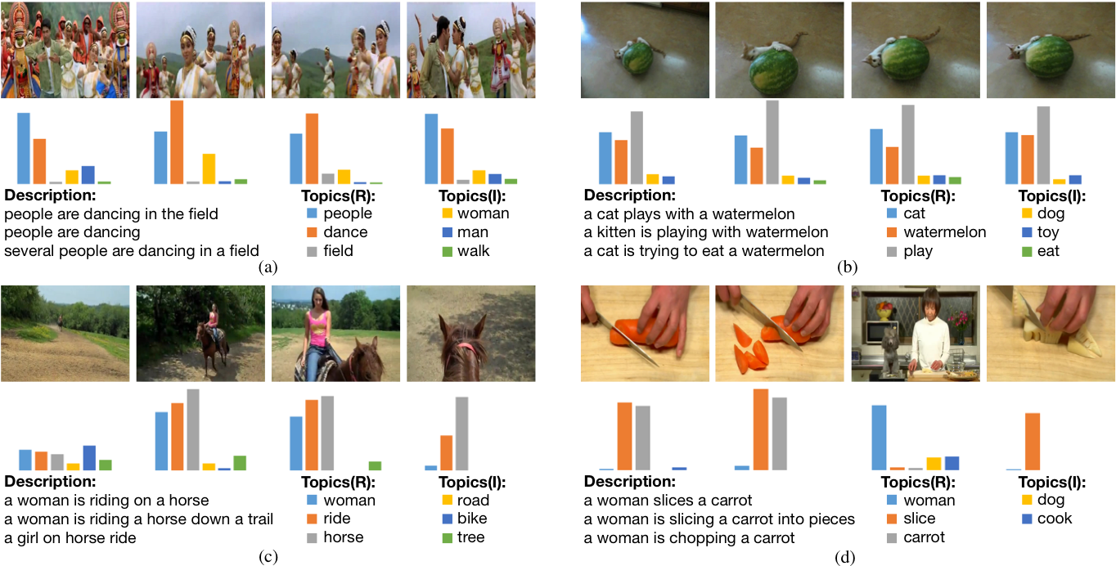
Feature Visualization

Slide 19
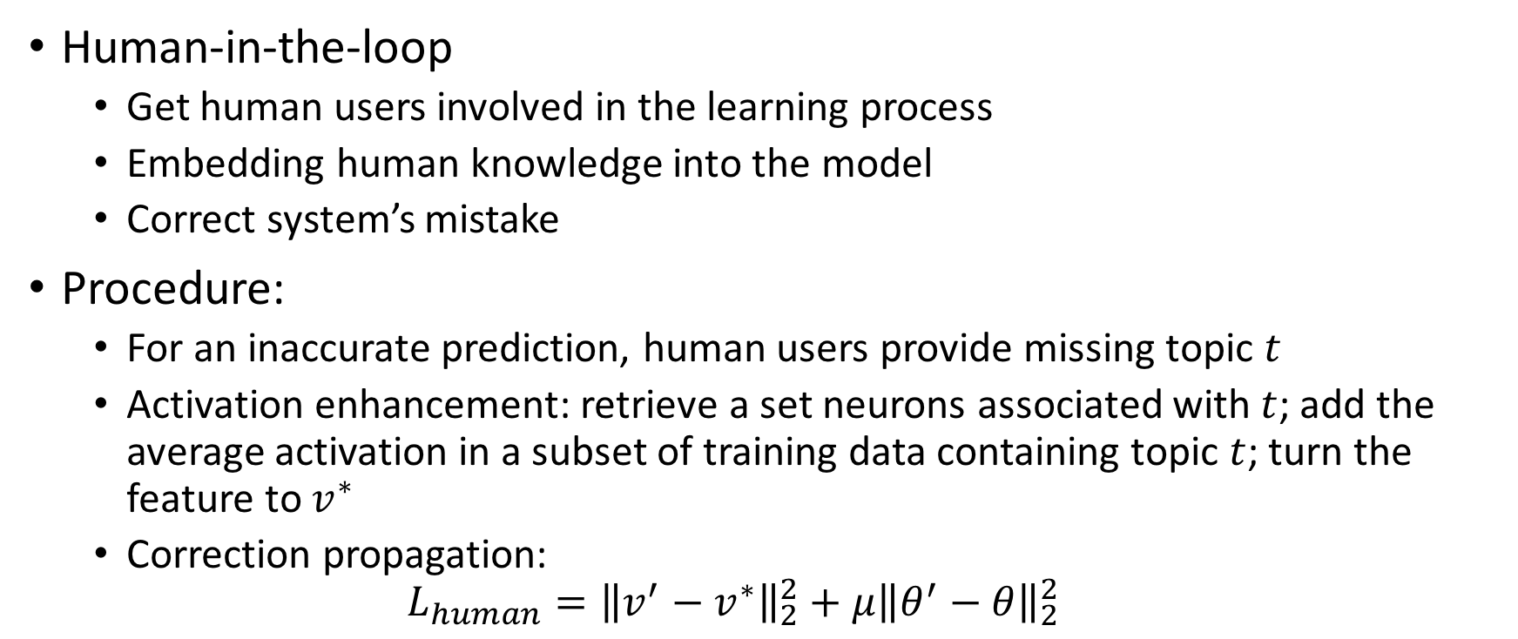
Human-in-the-loop Learning
Human-in-the-loop
Get human users involved in the learning process
Embedding human knowledge into the model
Correct system’s mistake
Procedure:
For an inaccurate prediction, human users provide missing topic $t$
Activation enhancement: retrieve a set neurons associated with $t$; add the average activation in a subset of training data containing topic $t$; turn the feature to $v^{∗}$
Correction propagation:
$$L_{human}={\left\|v^{′}−v^{∗}\right\|}_{2}^{2}+μ{\left\|θ^{′}−θ\right\|}_{2}^{2}$$

Slide 20
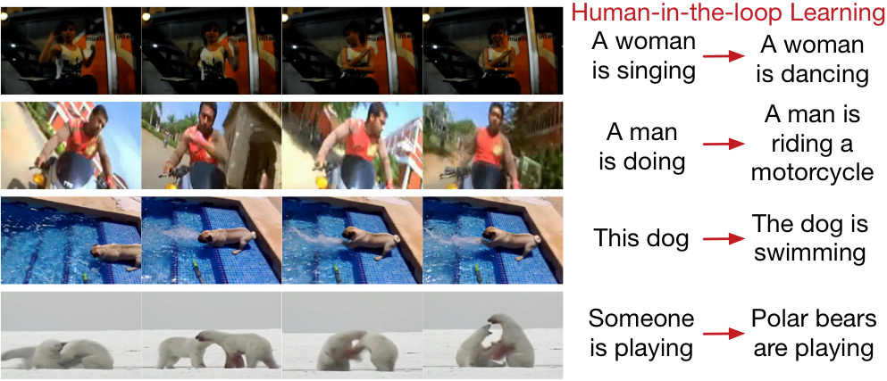
Human-in-the-loop Learning
Split each video into two parts; refine the model by the first half; test the performance by the second half

Slide 21
Q & A

